Slide 1
Comparing Two Means
Chapter 9

Slide 2
Experiments
Simple experiments
One IV that’s categorical (two levels!)
One DV that’s interval/ratio/continuous
For example, manipulation of the independent variable involves having an experimental condition and a control.
This situation can be analyzed with a t-test
Notes:
E.g., Is the movie Scream 2 scarier than the original Scream? We could measure heart rates (which indicate anxiety) during both films and compare them.

Slide 3
Experiments
Median splits are bad.
You separate the people who are close together and lump them with people who are not really like them.
Effect sizes get smaller.
Power/Type 2 problems.
So don’t make a continuous variable categorical just so you can do a t-test.

Slide 4
Experiments
Reminder: when you manipulate the levels of the IV, you are working with experimental research. If you just are examining two naturally occurring categories, then quasi-experimental/correlational.

Slide 5
Experiments
Between subjects / Independent designs
When the people are in separate levels and only do one of the manipulations
Repeated measures / within subjects / dependent designs
When the people get all of the levels

Slide 6
The t-test
Independent t-test
Compares two means based on independent data
E.g., data from different groups of people
Dependent t-test
Compares two means based on related data.
E.g., Data from the same people measured at different times.
Data from ‘matched’ samples.

Slide 7
The t-test
In the book, everything is taught as linear modeling.
One thing to know is that t-tests and ANOVAs are all special types of regression with categorical predictors.
Therefore, you can use one function to do all these analyses (lm), but we are going to use packages that are designed for each test to help get only the information we are interested in.

Slide 8
Independent t-test Example
Are invisible people mischievous?
24 Participants
Manipulation
Placed participants in an enclosed community riddled with hidden cameras.
12 participants were given an invisibility cloak.
12 participants were not given an invisibility cloak.
Outcome
measured how many mischievous acts participants performed in a week.
Chapter 9 invisible long.

Slide 9
Rational for the t-test
Let’s use the invisibility cloak data.
Two groups (levels!):
Cloak versus no cloak.
What would our null hypothesis be?
What would our research hypothesis be?

Slide 10
Rational for the t-test
Two samples of data are collected and the sample means calculated. These means might differ by either a little or a lot.
Let’s calculate the means.
Use tapply!

Slide 11
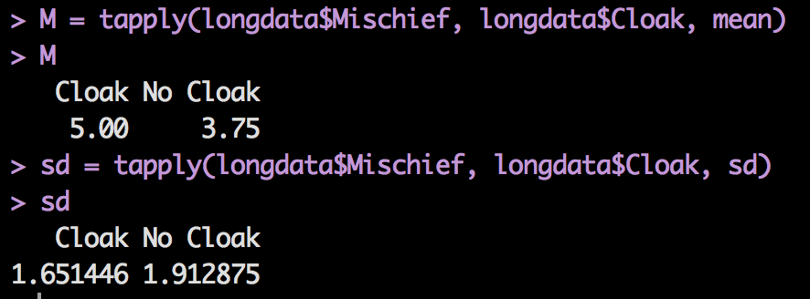
Means/SDs

Slide 12

Rational to Experiments
Group 1
Group 2
Lecturing Skills
Variance created by our manipulation
Removal of brain (systematic variance)
Variance created by unknown factors
E.g. Differences in ability (unsystematic variance)

Slide 13
Rational for the t-test
If the samples come from the same population, then we expect their means to be roughly equal. Although it is possible for their means to differ by chance alone, we would expect large differences between sample means to occur very infrequently.

Slide 14
Rational for the t-test
We compare the difference between the sample means that we collected to the difference between the sample means that we would expect to obtain if there were no effect (i.e. if the null hypothesis were true).
So Mean Cloak versus Mean No Cloak
If the null is true, what does that imply for the means?

Slide 15
Rational for the t-test
We use the standard error as a gauge of the variability between sample means. If the difference between the samples we have collected is larger than what we would expect based on the standard error then we can assume one of two.

Slide 16
Rational for the t-test
There is no effect and sample means in our population fluctuate a lot and we have, by chance, collected two samples that are atypical of the population from which they came.
The two samples come from different populations but are typical of their respective parent population. In this scenario, the difference between samples represents a genuine difference between the samples (and so the null hypothesis is incorrect).

Slide 17
Rational for the t-test
As the observed difference between the sample means gets larger, the more confident we become that the second explanation is correct (i.e. that the null hypothesis should be rejected).
If the null hypothesis is incorrect, then we gain confidence that the two sample means differ because of the different experimental manipulation imposed on each sample.

Slide 18
Rational for the t-test
t | = | observed difference between sample means | − | expected difference between population means (if null hypothesis is true)
 |  | estimate of the standard error of the difference between two sample means

Slide 19
The Independent t-test

Slide 20
The Independent t-test
What are all these parts in the things we’ve talked about?
DF
Standard deviation
Standard error

Slide 21
The Independent t-test
Ok, I’ve got t, now what?
The t table.
Why should I care? R gives me p?
Many Type 1 corrections require you to use t or q tables.

Slide 22
Independent t-test using R
All that data screening still applies.
With this data, univariate = multivariate because we only have one continuous measure to screen.
I usually always screen multivariate (until problems arise) because they are equal with one variable (so it’s one set of rules to remember).
More about this after we cover both test types.

Slide 23
Independent t-test using R
How to run a t-test in R
New function: t.test
Y ~ X … or you can think about this as DV ~ IV group. Most functions work in this format, so it will help to learn now.
Data = data
Var.equal = TRUE
Paired = False

Slide 24
Independent t-test using R
t.test(Mischief ~ Cloak, data = longdata, var.equal = TRUE, paired = FALSE)

Slide 25
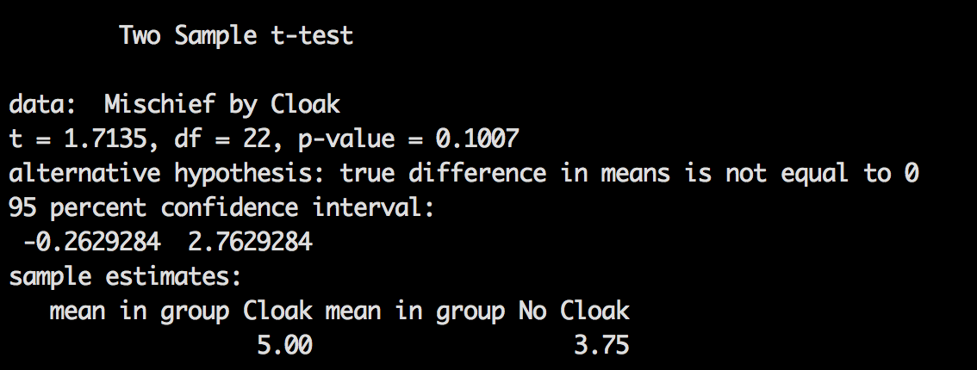
Independent t-test using R
t(22) = 1.71, p = .10, which is not significant.

Slide 26
Calculating the Effect Size
Effect size options:
Cohen’s d
Hedges’ g
Glass’ delta
r
Which one should I use?

Slide 27
MOTE!
You can use our free effect size calculator (woo!).
You can also use the calculator to make sure you’ve gotten t correct.
Demo here over mote.

Slide 28
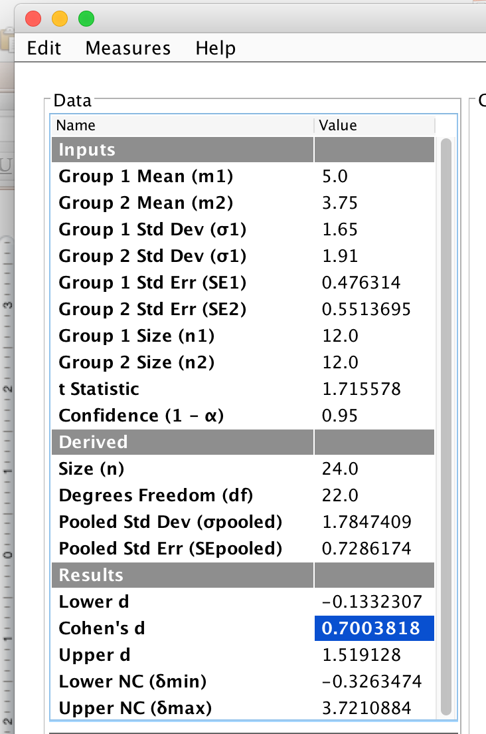
MOTE
t(22) = 1.71, p = .10, d = 0.70

Slide 29
GPower
We didn’t get a significant effect, but found a medium effect size. How many participants do we actually need to find a significant effect?

Slide 30
GPower
Test family = t test
Statistical test = means, difference between two independent means (two groups)
Tails = two
Effect size = fill in d (.70)
Alpha = .05
Power = .80
Allocation ratio = 1

Slide 31
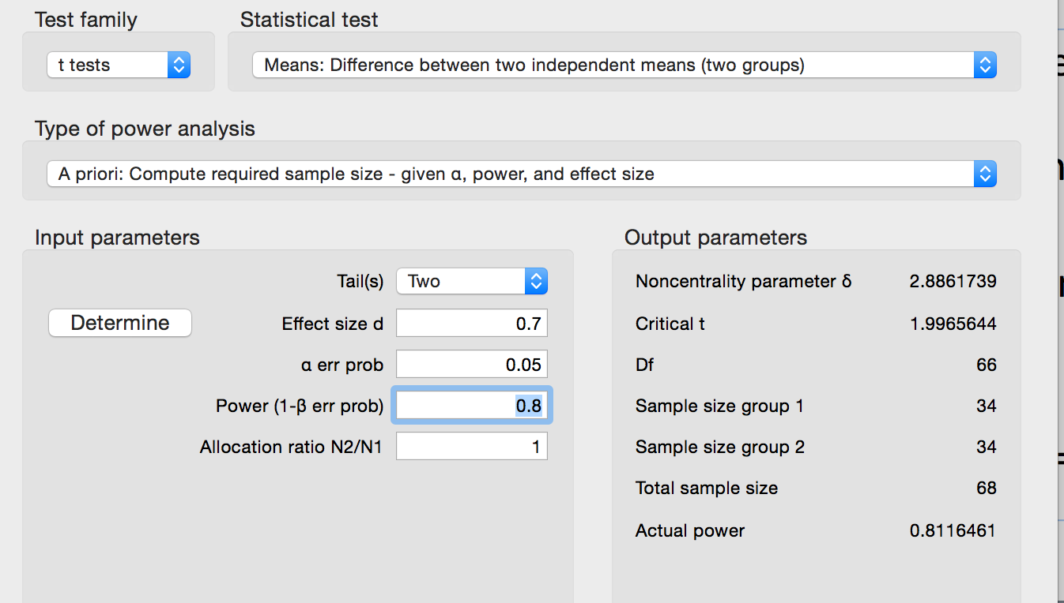
So, we would need 68 people.

Slide 32
Reporting the independent t-test
On average, participants given a cloak of invisibility engaged in more acts of mischief (M = 5.00, SD = 1.65), than those not given a cloak (M = 3.75, SD = 1.91). This difference was not significant t(22) = 1.71, p = .10; however, it did represent a medium-sized effect d = .70.
(two decimals!).

Slide 33
Dependent t-test Example
Are invisible people mischievous?
24 Participants
Manipulation
Placed participants in an enclosed community riddled with hidden cameras.
For first week participants normal behaviour was observed.
For the second week, participants were given an invisibility cloak.
Outcome
measured how many mischievous acts participants performed in week 1 and week 2.
Same data, just treat it as dependent now. Let’s see what happens to our t-test.

Slide 34
Dependent t-test
The logic of this test is roughly the same, but you have to consider the matched nature of dependent results.
So now we are going to use the standard error of the differences rather than standard error.

Slide 35
The Dependent t-test

Slide 36
The Dependent t-test in R
Same code as before, but change paired = FALSE to paired = TRUE.
t.test(Mischief ~ Cloak, data = longdata, var.equal = TRUE, paired = TRUE)

Slide 37
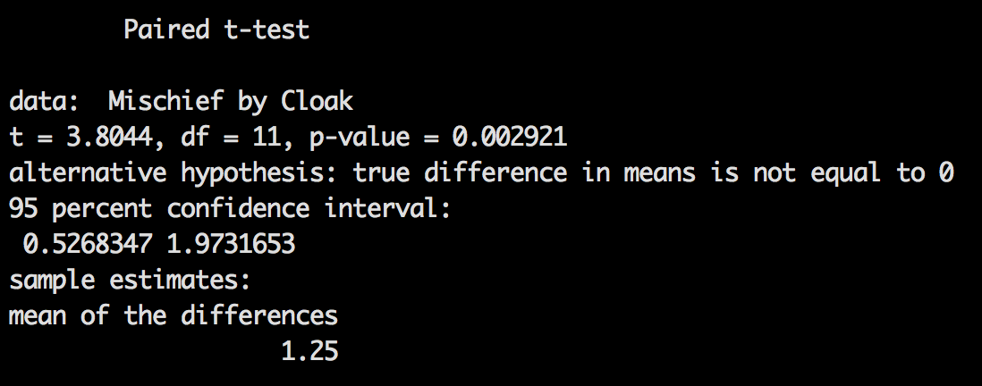
The Dependent t-test in R
t(11) = 3.80, p = .003
Whoa! Look how different it is!

Slide 38
Calculating an Effect Size
Effect size options:
Cohen’s d
Based on averages
Based on differences
Which one should I use?

Slide 39
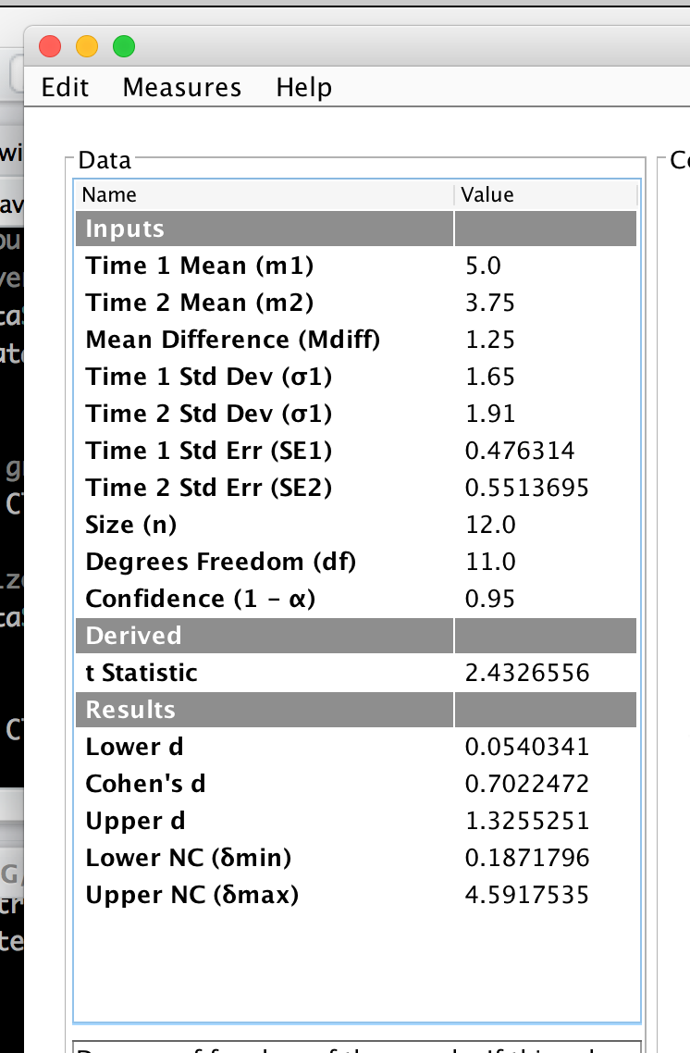
MOTE
D averages
NOTE: t will NOT match.
t(11) = 3.80, p = .003, d = .70

Slide 40
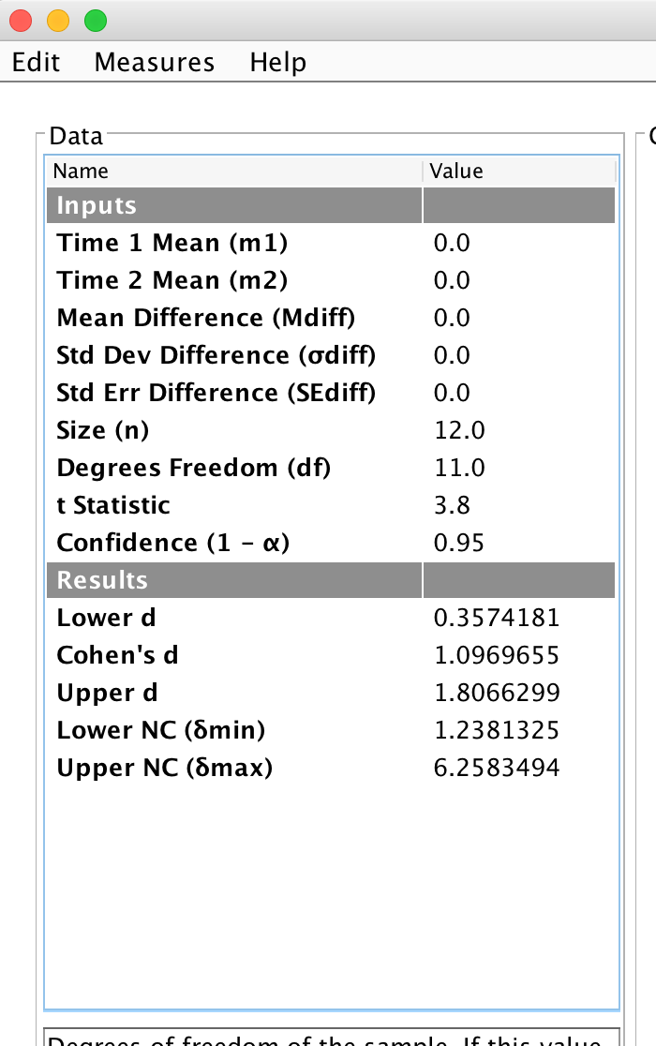
MOTE
D difference
NOTE: use t to calculate
t(11) = 3.80, p = .003, d = 1.10

Slide 41
Reporting the dependent t-test
On average, participants given a cloak of invisibility engaged in more acts of mischief (M = 5.00, SD = 1.65), than those not given a cloak (M = 3.75, SD = 1.91). This difference was significant t(11) = 3.80, p = .003 and represented a medium-sized effect d_{avg} = .70.

Slide 42
GPower
Well, this test was significant – but how many people would we have needed?
Remember how we said that type of test was one of the things that changed power??

Slide 43
GPower
Test family = t test
Statistical test = means, difference between two dependent means (matched groups)
Tails = two
Effect size = fill in d (.70 or 1.09)
Alpha = .05
Power = .80

Slide 44
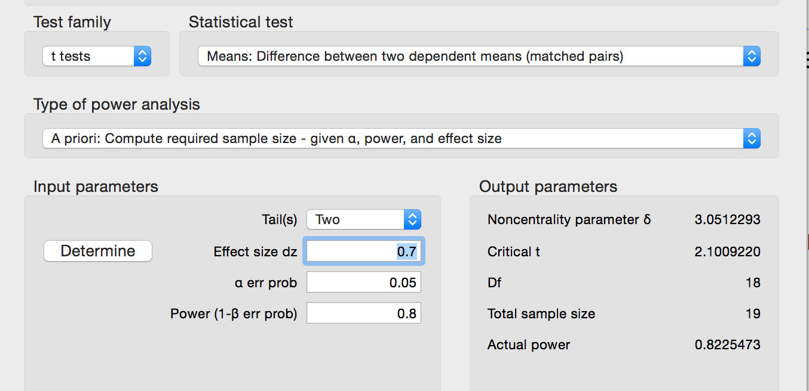
In the first test we needed 68 … now we only need 19 – that’s why repeated measures is awesome.

Slide 45
Graphs for t-tests
Bar charts in ggplot2 with only one x variable (the different levels of your IV) and one y variable.
Simple bar graph
ggplot(data, aes(group variable, dv variable))
+ theme + xlab + ylab + stat_summary (x2)

Slide 46
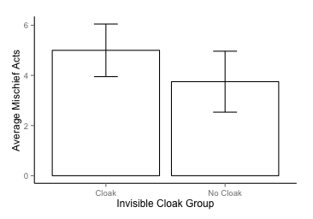
Graph

Slide 47
Assumptions of the t-test
Both the independent t-test and the dependent t-test are parametric tests based on the normal distribution. Therefore, they assume:
The sampling distribution is normally distributed. In the dependent t­-test this means that the sampling distribution of the differences between scores should be normal, not the scores themselves.
Data are measured at least at the interval level.

Slide 48
Assumptions of the t-test
The independent t-test, because it is used to test different groups of people, also assumes:
Variances in these populations are roughly equal (homogeneity of variance).
Scores in different treatment conditions are independent (because they come from different people).

Slide 49
Assumptions of the t-test
In plain old English,
Accuracy, missing, outliers are dealt with
Independence
Normality
Linearity
Homogeneity/Homoscedasticity
(basically not multicollinearity because there’s only one DV).

Slide 50
When Assumptions are Broken
The most common problem is homogeneity … where the group variance is not equal between groups.
You can easily adjust for variances using the Welch (or Satterthwaite) approximation to the degrees of freedom
Set var.equal = FALSE to use this adjustment.

Slide 51
When Assumptions are Broken
Dependent t-test
Mann-Whitney Test
Wilcoxon rank-sum test
Independent t-test
Wilcoxon Signed-Rank Test
Robust Tests:
Bootstrapping
Trimmed means
These tests are better when linearity or normality in small samples are not meet.

